Slide 1


Slide 2
Technical Writing using LaTeX
Dr. Manoj Kumar M V
Professor
Department of Information Science and Engineering
Nitte Meenakshi Institute of Technology, B’lore

Slide 3
Git Repository
https://github.com/manojmv24/AEC-Technical-Writing-using-LaTeX

Slide 4
LaTeX (pronounced as "Lah-tech" or "Lay-tech") is a document preparation system and typesetting program widely used for producing scientific and technical documents. It allows users to focus on the content of the document rather than its formatting by using predefined commands to structure text, format equations, and create complex documents.

Slide 5
Key Features of LaTeX:
Typesetting for High-Quality Output:
  LaTeX excels in producing beautifully formatted text, especially for documents with mathematical symbols, complex formulas, tables, and figures.
  It generates professional-quality PDFs or other output formats.

Slide 6
Key Features of LaTeX:
Structured Document Creation:
  LaTeX follows a logical approach to document structure. It uses commands to define sections, paragraphs, headings, lists, and more.
  Documents are written using plain text, with commands to define the structure and formatting.

Slide 7
Key Features of LaTeX:
Automated Formatting:
  LaTeX takes care of formatting (such as font size, paragraph indentation, etc.) based on predefined document classes (e.g., article, book, report).
  It handles bibliographies, cross-references, indexes, and tables of contents automatically.

Slide 8
Key Features of LaTeX:
Extensive Mathematical Capabilities:
  LaTeX is renowned for its ability to handle complex mathematical notation with ease. It’s the go-to tool for academics in fields like mathematics, physics, and engineering.

Slide 9
Key Features of LaTeX:
Modularity with Packages:
  LaTeX can be extended with various packages to add extra functionality, such as managing bibliographies (biblatex), including graphics (graphicx), or creating presentations (beamer).

Slide 10
How LaTeX Works:
Source Code: You write LaTeX documents in a .tex file using plain text with LaTeX commands.
Compilation: The .tex file is then compiled by a LaTeX engine (such as TeX Live) into an output file (usually PDF).

Slide 11
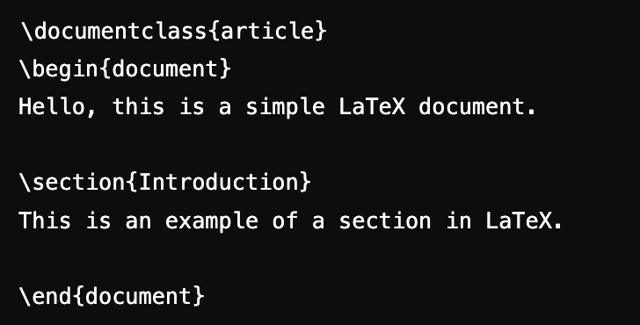
How LaTeX Works:
Example of LaTeX code:
This will generate a PDF with a formatted title "Introduction" and some basic text.

Slide 12
Common Uses of LaTeX:
Academic papers: Journals and conferences often require submissions in LaTeX.
Books and Theses: LaTeX is ideal for large documents with complex structures.
Presentations: LaTeX can be used to create high-quality presentations using packages like beamer.
Mathematical and Scientific Notation: LaTeX is highly preferred for writing papers involving complex equations and symbols.

Slide 13
Why Use LaTeX?
Consistency and Quality: LaTeX ensures consistent formatting across the document and produces a professional-quality output.
Mathematical Precision: It provides excellent tools for precise typesetting of mathematical equations.
Automation: It can automatically handle bibliographies, citations, numbering of figures/tables, and cross-referencing.
Customization: Users can customize or extend LaTeX's capabilities with packages to meet specific needs.

Slide 14


Slide 15
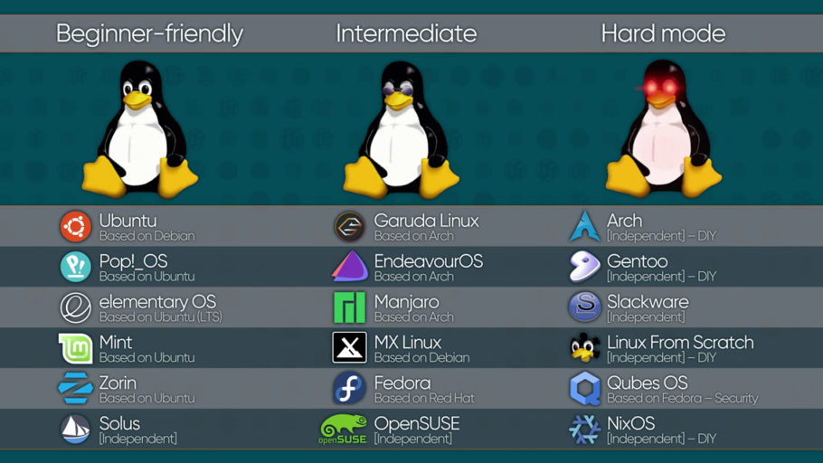

Slide 16


Slide 17


Slide 18



Slide 19
Step 1: Update the System
Before installing any software, it is always a good idea to update your package lists.
Open the terminal and type the following command:
sudo apt update
sudo apt upgrade
This will ensure your system is up to date.
Notes:
The full form of sudo is "superuser do".
It is a command in Unix and Linux-based operating systems that allows a permitted user to execute a command as the superuser (also known as root) or another user with elevated privileges.
In simple terms, sudo temporarily grants administrative permissions to execute specific tasks that normally require root access.

Slide 20
Step 2: Install TeX Live (LaTeX Distribution)
TeX Live is a comprehensive LaTeX distribution. You can install it with the following command:
sudo apt install texlive-full
This command will install the complete TeX Live distribution, which includes all the LaTeX packages, fonts, and utilities you will need. It might take a while, as the package is large.

Slide 21
Step 2: Install TeX Live (LaTeX Distribution)
If you want a smaller installation, you can use the following command to install only the basic LaTeX packages:
sudo apt install texlive

Slide 22
Step 3: Install TeXstudio
TeXstudio is a popular LaTeX editor. To install it, run the following command:
sudo apt install texstudio

Slide 23
Step 4: Verify the Installation
Once the installation is complete, you can verify it by running TeXstudio from the terminal or searching for it in your application menu.
To launch TeXstudio from the terminal:
texstudio

Slide 24
Step 5: Configure TeXstudio
Open TeXstudio: Once you have TeXstudio running, you may want to configure it to use the LaTeX distribution.
Go to Options →Configure TeXstudio.
Check LaTeX Compiler: In the 'Build' section, make sure that the path to pdflatex is set correctly (usually, it will detect TeX Live automatically).
Quick Build Command: Set the Quick Build command to PdfLaTeX + View PDF for a basic LaTeX workflow.

Slide 25
Step 6: Test the Installation
Create a new document in TeXstudio by going to File → New.
Copy and paste this simple LaTeX code into the editor:
\documentclass{article}
\begin{document}
Hello, LaTeX!
\end{document}

Slide 26
Step 6: Test the Installation
Save the document with a .tex extension (e.g., hello.tex).
Press F5 or click on the 'Build & View' button to compile and view the PDF.’
If everything is installed correctly, you should see a PDF file displaying "Hello, LaTeX!"

Slide 27


Slide 28


Slide 29
Step 1: Download and Install MiKTeX (LaTeX Distribution)
MiKTeX is a popular LaTeX distribution for Windows. It includes all the necessary tools to compile LaTeX documents.
Go to the MiKTeX website:
Visit https://miktex.org/download and download the installer for Windows.
Run the Installer:
After downloading, run the MiKTeX installer (.exe file) and follow the on-screen instructions:
  Select the installation folder.
  Choose whether to install MiKTeX for "Only for me" or "Anyone who uses this computer."
  Make sure to enable the option for MiKTeX to install missing packages on the fly (recommended).
Complete the Installation:
Once the installation is complete, MiKTeX will be ready to use. It may ask to update the package database during installation—accept this option if prompted.

Slide 30
Step 2: Download and Install TeXstudio (LaTeX Editor)
TeXstudio is a LaTeX editor that provides a user-friendly interface for writing LaTeX documents.
Go to the TeXstudio website:
Visit https://www.texstudio.org and download the Windows installer.
Run the Installer:
Run the TeXstudio installer and follow the setup wizard:
  Accept the default installation options.
  Choose the installation folder and complete the setup.

Slide 31
Step 3: Configure TeXstudio with MiKTeX
Open TeXstudio:
Once TeXstudio is installed, open the application.
Configure the LaTeX Compiler:
By default, TeXstudio should automatically detect MiKTeX as the LaTeX distribution. However, if you want to manually verify or configure the compiler:
  Go to Options → Configure TeXstudio.
  Select Build on the left side and ensure that the Default Compiler is set to PdfLaTeX.
  You can also choose a different compiler if needed (like XeLaTeX or LuaLaTeX).
Set the Default Viewer:
In the same settings window, under Build, make sure the "PDF Viewer" is set to "Internal PDF Viewer" so that you can preview the compiled PDF directly in TeXstudio.

Slide 32
Step 4: Test the Setup
Create a New LaTeX Document:
In TeXstudio, go to File → New to create a new document. Write a simple LaTeX document such as:
\documentclass{article}
\begin{document}
Hello, LaTeX on Windows!
\end{document}
Save the Document:
Save the document with a .tex extension (e.g., test.tex).
Compile and View the PDF:
Press F5 (or click the "Build & View" button) to compile the document and view the resulting PDF.

Slide 33
Step 5: Updating MiKTeX
It's a good practice to keep MiKTeX up to date:
Open MiKTeX Console:
Search for "MiKTeX Console" in the Windows Start menu.
Check for Updates:
In the MiKTeX Console, click on Updates and install any available updates to keep your LaTeX packages up to date.

Slide 34
Step 6: Installing Additional Packages (Optional)
If you need extra LaTeX packages, MiKTeX can install them automatically when compiling a document that uses them. Alternatively, you can manually install packages through the MiKTeX Console:
  Open the MiKTeX Console.
  Navigate to Packages.
  Search for the package you need and click Install.

